Slide 1

Atliq Hardware Business Insights360
By Sanchita Dasgupta

Slide 2
Content
Company Overview & Problem Statement
Data Model & Functional Knowledge
Data Modelling
Dashboard Overview
Insights & Recommendation

Slide 3
ATLIQ HARDWARE
AtliQ Hardware is a one of the fastest growing hardware company all over India and outside of India .They sells PC, mouse , computer , CPU to different companies .However suddenly they experience huge loss in Latin America so they have decided the data analyst team to bring the transparency as their loss is basically of their some basic surveys which prepared with excel tools.

Slide 4
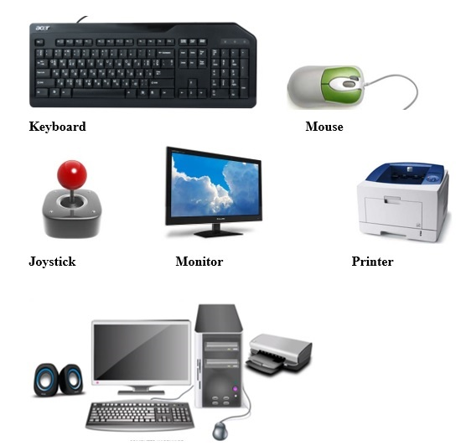





Consumer
AtliQ Hardware
Customer

Slide 5

PLATFORMS
Brick & Mortar
E -Commerce

Slide 6
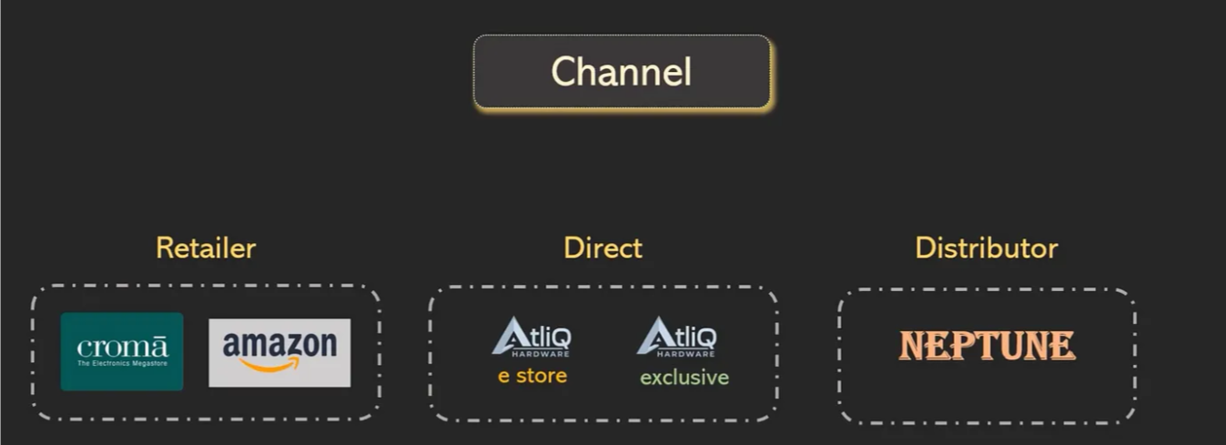

Slide 7
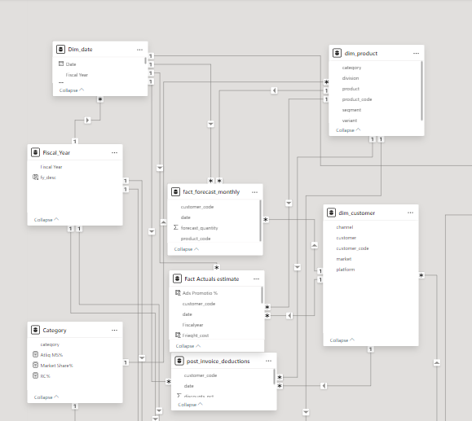
STAR SCHEMA

Slide 8
INSIGHTS & RECOMMENDATION
Insights:
Revenue Trends: Highlight growth trends, with a focus on quarterly or year-over-year changes.
Top Products/Segments: Identify highest revenue-generating products or customer segments.
Regional Performance: Showcase top-performing regions by revenue and profitability.
Customer Patterns: Emphasize key customer demographics and seasonal trends.
Recommendations:
Invest in High-Margin Products to maximize profitability.
Expand Marketing in Top Regions to leverage high revenue areas.
Targeted Campaigns based on demographic insights to enhance engagement and sales.

Slide 9
Thank
YOU

